Slide 1

Comprehensive Design of Intelligent Systems

Slide 2


Case Study
Alibaba Cloud City Brain

Slide 3
Overview of the City Brain
Alibaba Cloud City Brain is an artificial intelligence development, innovation, and operation platform built based on new-generation information technologies such as cloud computing, big data, artificial intelligence, and the Internet of Things. As a new infrastructure supporting the sustainable development of future cities, City Brain is conducive to promoting the digital transformation and upgrading of urban governance, security assurance, industrial development, public services, and other fields, improving urban governance capabilities, enhancing government management capabilities, and realizing the scientization, refinement, and intelligence of governance capabilities. City Brain uses rich urban data resources to conduct global real-time analysis of the city, promptly correct urban operation defects, promote sustainable urban development, and achieve "three breakthroughs" in urban governance models, urban service models, and urban industrial development.

Slide 4



Overview of the City Brain
Breakthrough in Urban Governance Model
Breakthrough in Urban Industrial Development
Breakthrough in Urban Service Model
Taking urban data from various aspects such as social structure, social environment, and social activities as resources, we can obtain manpower and service capabilities from data, solve prominent problems in urban governance, and realize an innovative humanized governance model.
City Brain is a very important material foundation for the government to serve the people's livelihood. Relying on City Brain, it can provide more accurate services to enterprises and individuals. Urban public services, such as transportation and medical care, will enter an era of precise and efficient services, eliminating the waste of public resources.
Open urban data resources are very important basic resources for promoting the upgrading and transformation of traditional industries and innovating industrial development, just like the role of oil and semiconductor materials in driving industrial development.

Slide 5
City Brain: Urban Traffic Governance Solution
Urban traffic governance integrates all traffic data such as urban traffic detectors, floating vehicles, videos, and signaling, conducts online and offline multi - source data fusion, builds a unified road network center, accurately depicts urban traffic flow, and establishes a scientific and accurate traffic evaluation system. Based on data - driven + artificial intelligence cloud computing technology, it builds an urban intelligent transportation system in the big data era, innovates an artificial intelligence signal timing system combining "machine intelligence + expert intelligence"; establishes a multi - dimensional intelligent research and judgment intelligence system for traffic efficiency, illegal inspection, key people and vehicles, etc., and realizes the "information, command, operation, and supervision" of road traffic management through the full closed - loop process of "perception - research and judgment - command - disposal - supervision". It conducts unified command and dispatch through the platform, improves the carrying capacity and operation efficiency of urban traffic services, improves the urban operation environment, and enhances the intelligent level of the entire urban traffic management services.

Slide 6
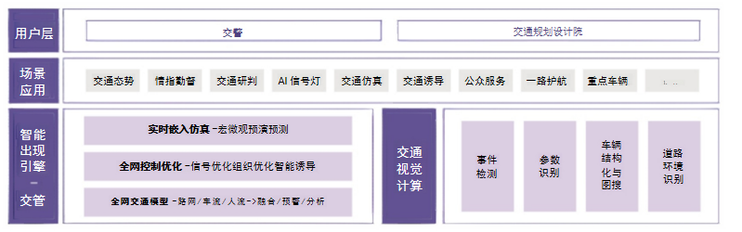
City Brain: Urban Traffic Governance Solution

Slide 7
City Brain: Urban Traffic Governance Solution
Urban traffic governance integrates all traffic data such as urban traffic detectors, floating vehicles, videos, and signaling, conducts online and offline multi - source data fusion, builds a unified road network center, accurately depicts urban traffic flow, and establishes a scientific and accurate traffic evaluation system. Based on data - driven + artificial intelligence cloud computing technology, it builds an urban intelligent transportation system in the big data era, innovates an artificial intelligence signal timing system combining "machine intelligence + expert intelligence"; establishes a multi - dimensional intelligent research and judgment intelligence system for traffic efficiency, illegal inspection, key people and vehicles, etc., and realizes the "information, command, operation, and supervision" of road traffic management through the full closed - loop process of "perception - research and judgment - command - disposal - supervision". It conducts unified command and dispatch through the platform, improves the carrying capacity and operation efficiency of urban traffic services, improves the urban operation environment, and enhances the intelligent level of the entire urban traffic management services.

Slide 8
City Brain: Urban Traffic Governance Solution
Alibaba Cloud City Brain traffic governance solution provides a data fusion engine based on multi - source data such as Amap data, video data, and various traffic perceptions, a real - time early warning engine for real - time early warning of traffic anomalies, a deep analysis engine for comprehensive analysis, which has now been upgraded to a network - wide model engine; and a control optimization engine for traffic signal optimization control and a traffic simulation engine for accident preview/analysis and disposal.

Slide 9
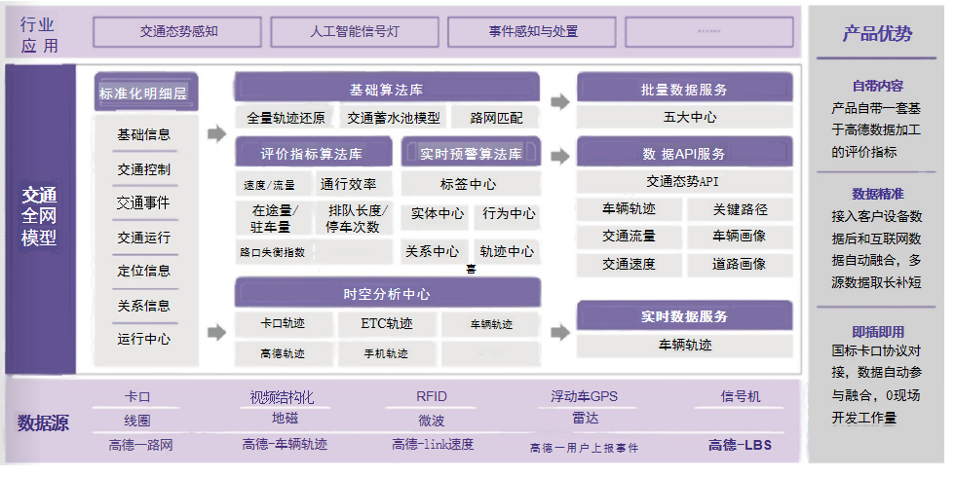
City Brain: Urban Traffic Governance Solution
The traffic network - wide model provides a set of evaluation indicators, event early warning, and cause analysis based on multi - source data fusion for business applications, enabling the computability of the road network.

Slide 10
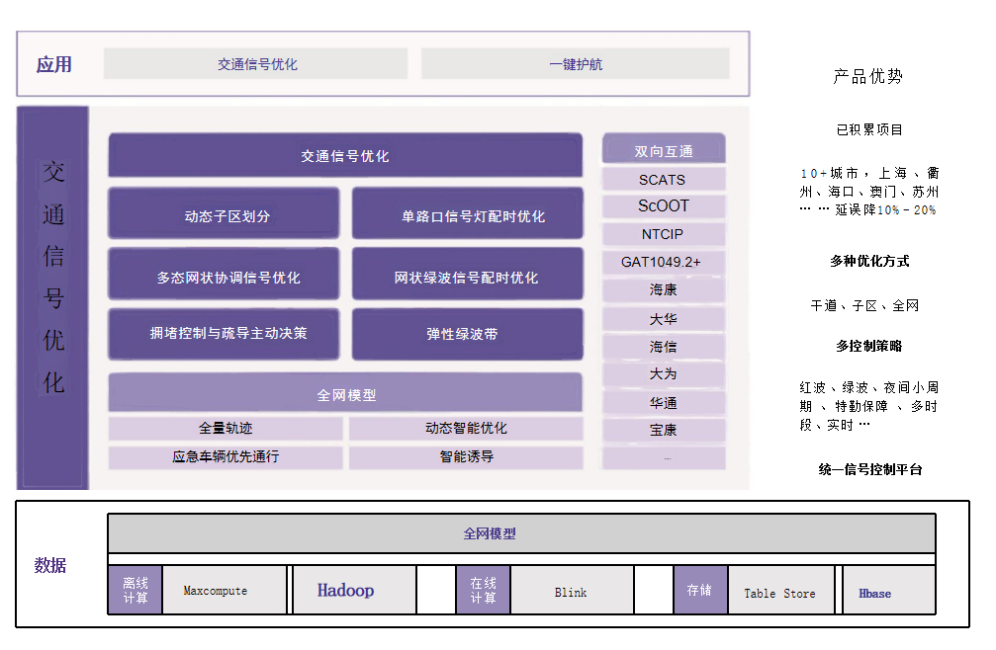
City Brain: Urban Traffic Governance Solution
Traffic control optimization generates control strategies such as signal timing optimization, elastic green wave belts, path planning, and traffic guidance, effectively exerting the traffic regulation capabilities of signal lights, guidance screens, map navigation, etc., thereby improving traffic efficiency, reducing traffic flow conflicts, and enhancing driving safety.

Slide 11
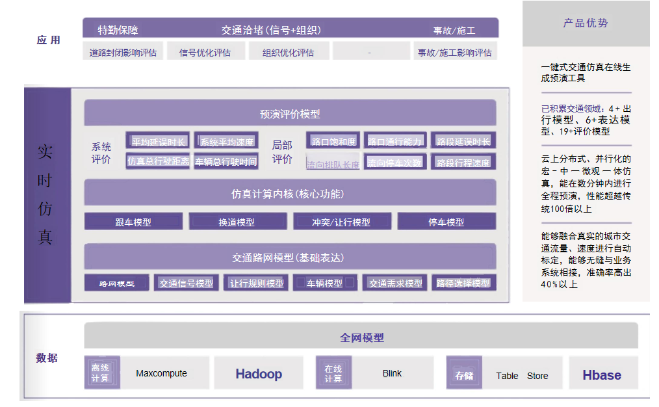
City Brain: Urban Traffic Governance Solution
Real - time simulation is an urban traffic simulation engine that improves large - scale distributed, macro - micro integration, and fuses real data with simulation models. It can be directly embedded into various business links of traffic management to provide what - if restoration and prediction.

Slide 12
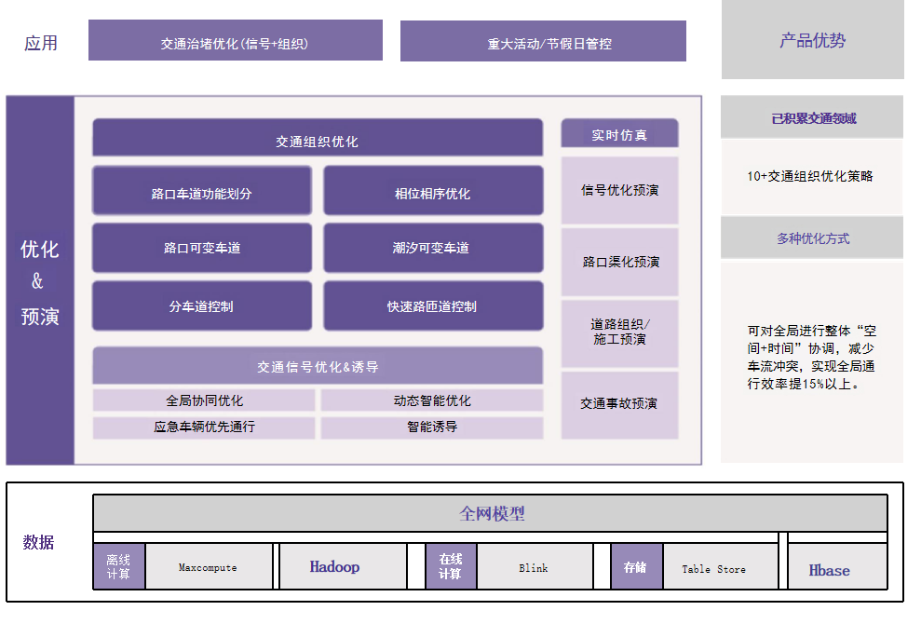
City Brain: Urban Traffic Governance Solution
By effectively utilizing road space, traffic organization optimization enhances traffic supply capacity in terms of vehicle carrying rate, thereby saving travel time, reducing traffic flow conflicts, and improving driving safety.

